Slide 1
Next (or 2nd) Generation Sequencing

Slide 2
Learning Objectives
To learn about next generation sequencing technologies
To understand differences in sequence approaches and techniques

Slide 3
Next Generation Sequencing (NGS)
Modern sequencing technologies are highly parallelized, leading to an exponential decrease in cost per base.
“$1000 Genome” no longer just a catch phrase
Paradigm switch from lower coverage with longer reads (Sanger) toward higher coverage with shorter reads (NGS)

Slide 4
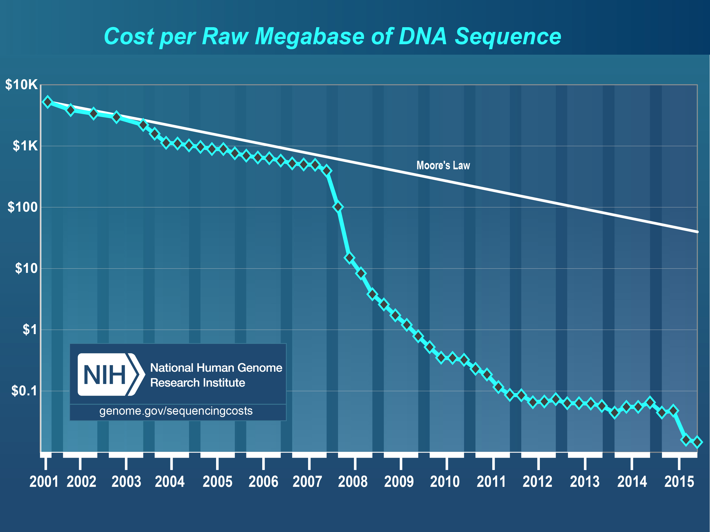

Slide 5
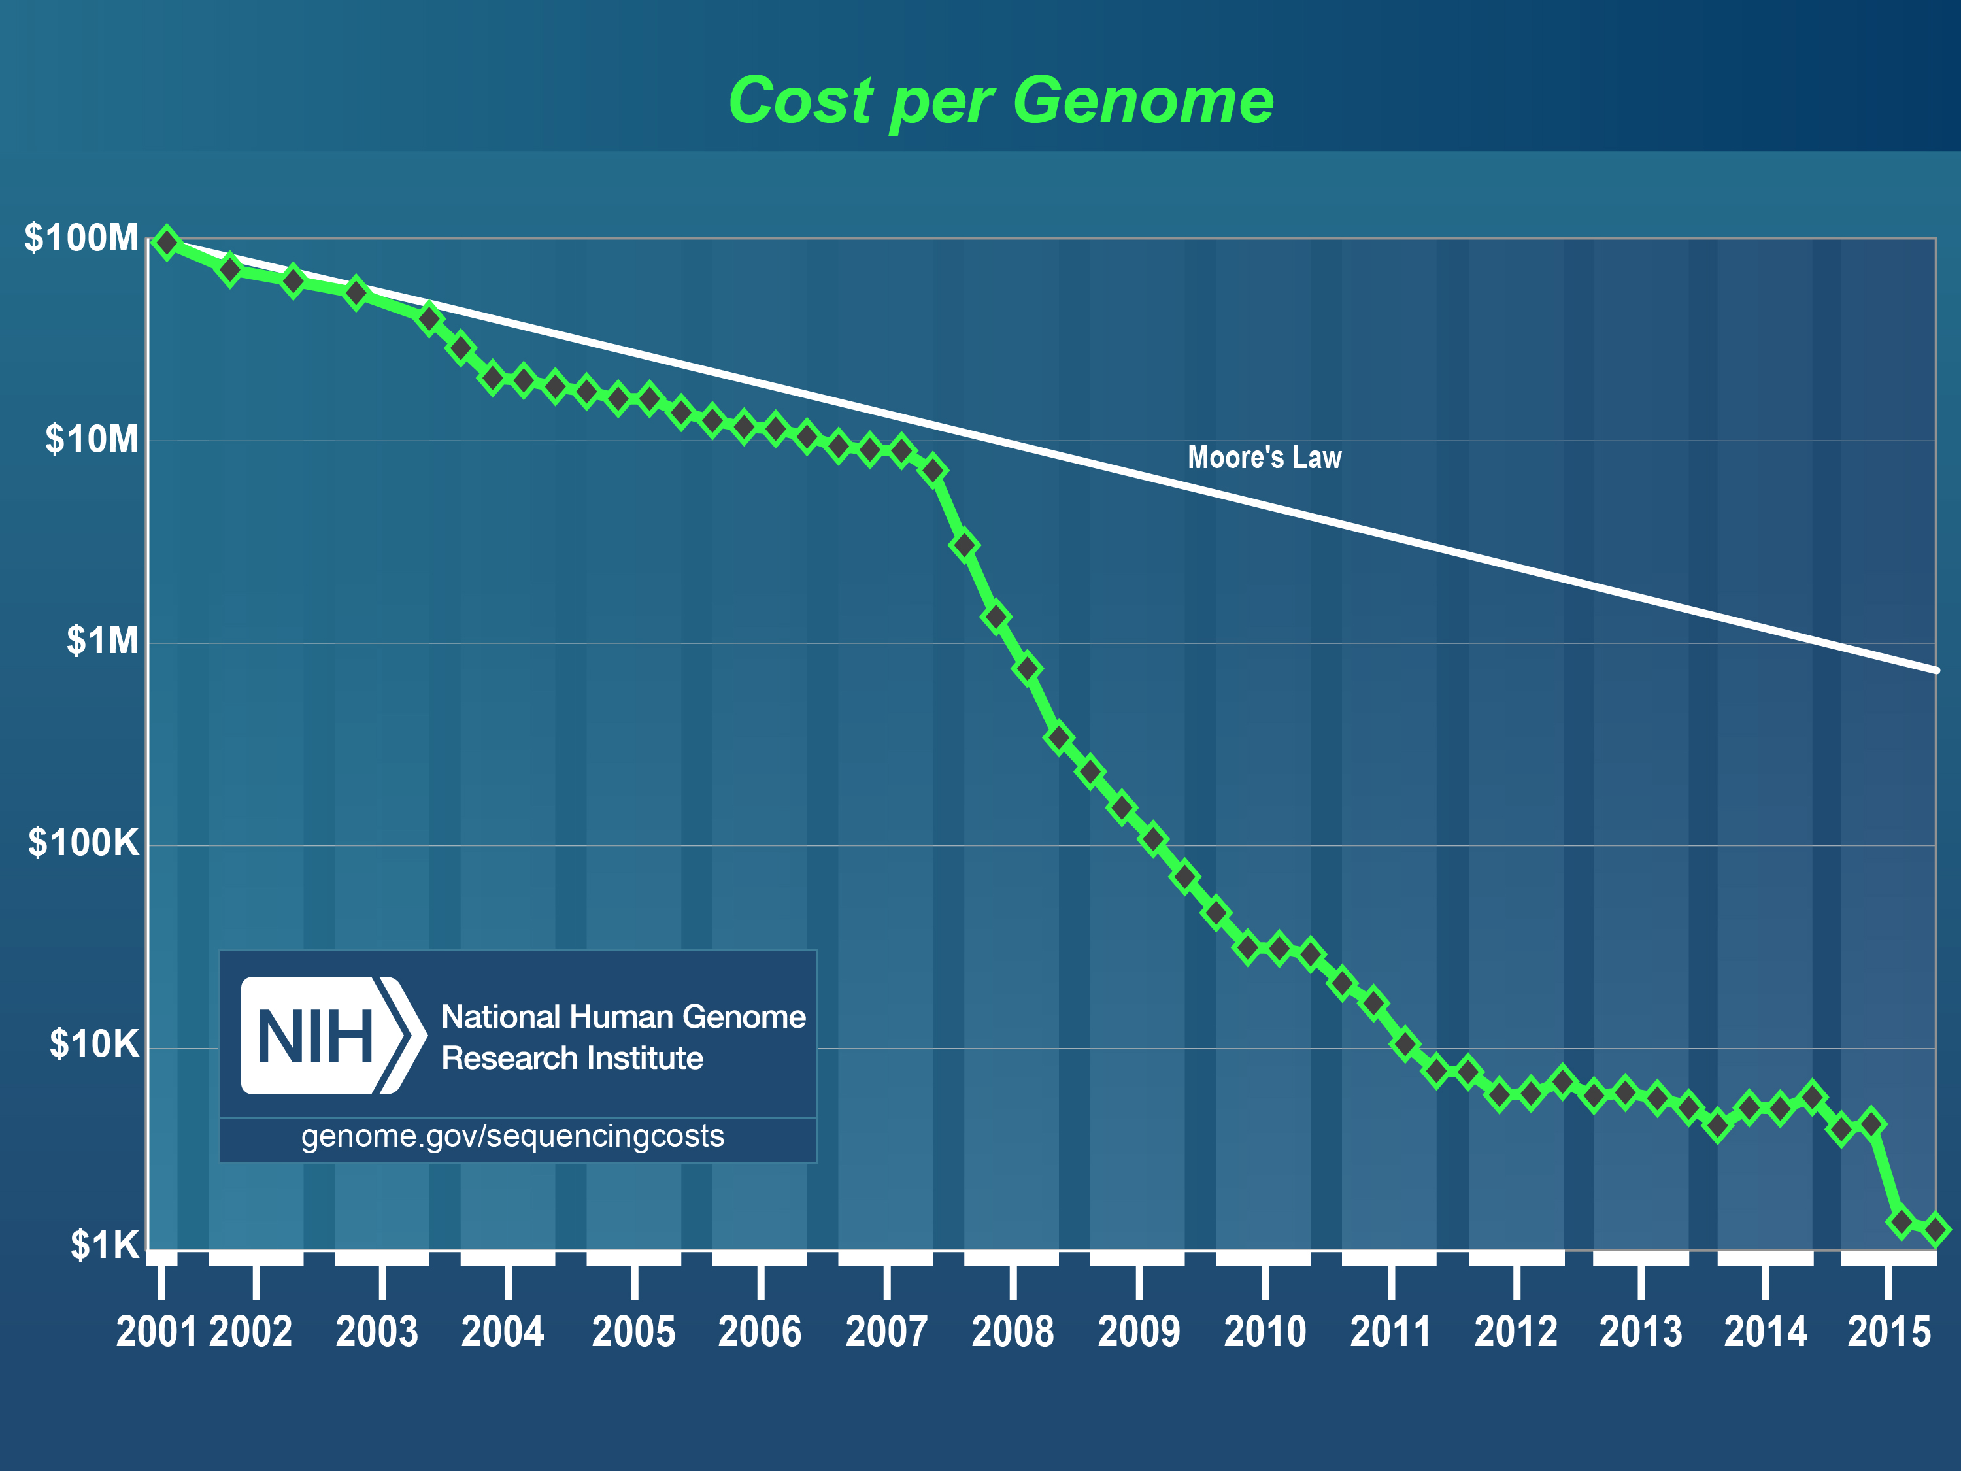

Slide 6
Major NGS Concepts
Sequencing by Synthesis: Uses a polymerase to incorporate and assess nucleotides to a primer sequence
Cyclic reversible termination (CRT)
Single-nucleotide addition (SNA)
Sequencing by Ligation: Uses a ligase to attach hybridized sequences to a primer sequence
1 or more nucleotides at a time (e.g. dibase)

Slide 7
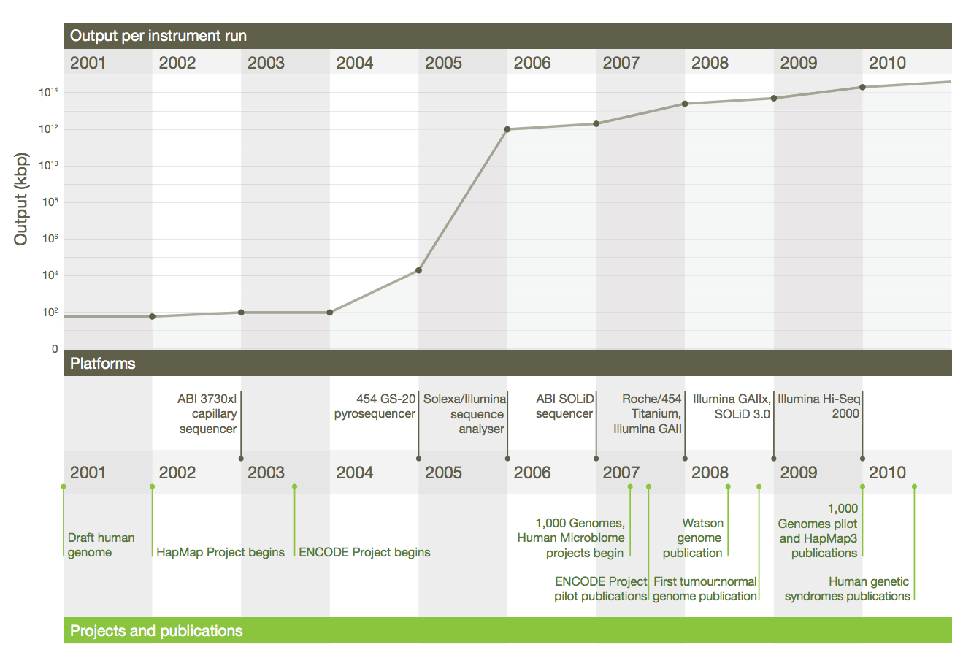
Timeline of Sequencing Capacity
Mardis, ER (2011), Nature, 470, pp. 198-203

Slide 8
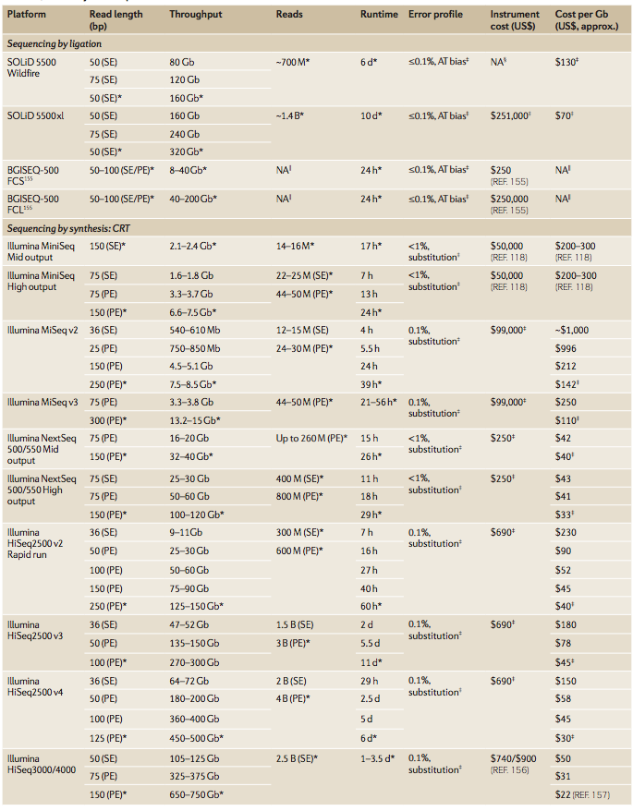
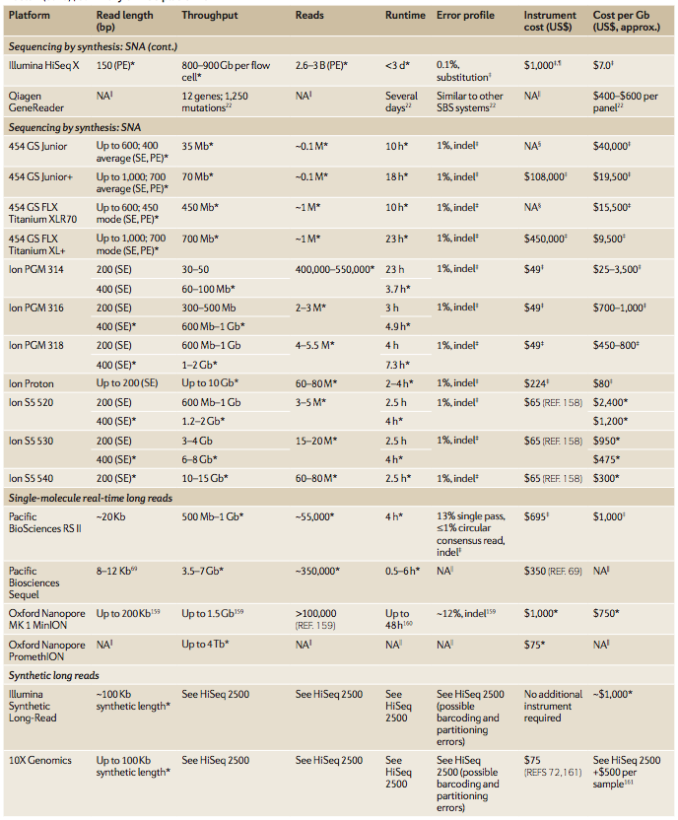
‘Modern’ NGS Sequencing Platforms
Goodwin, S et al (2016), Nat. Rev. Genet., 17, pp. 333- 51

Slide 9
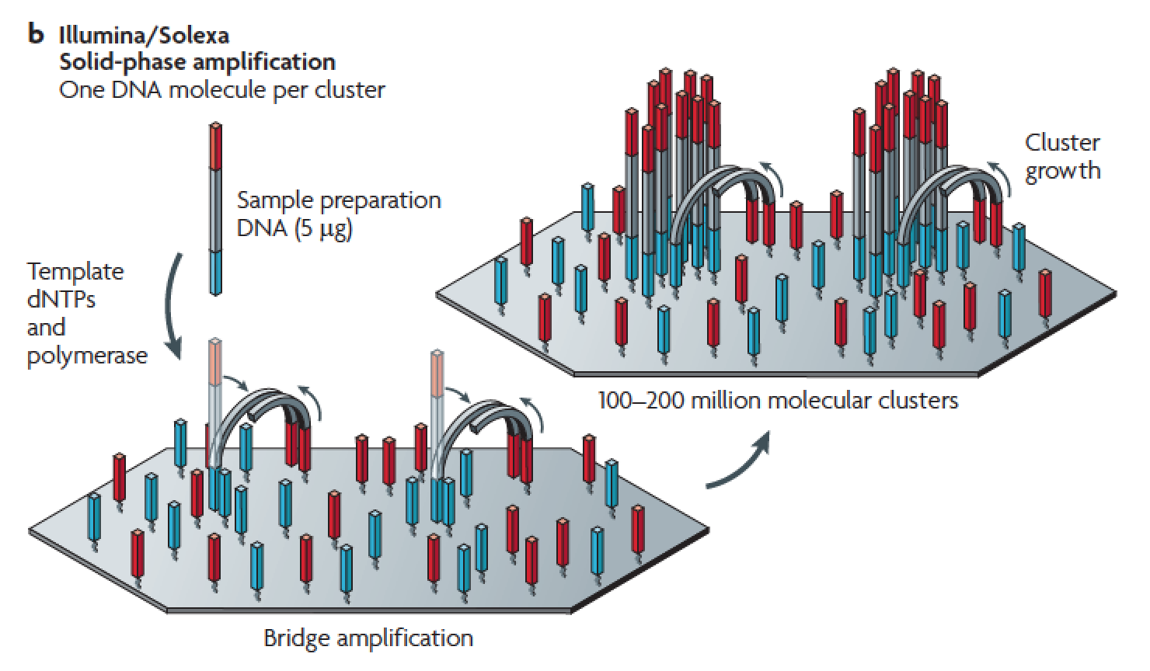
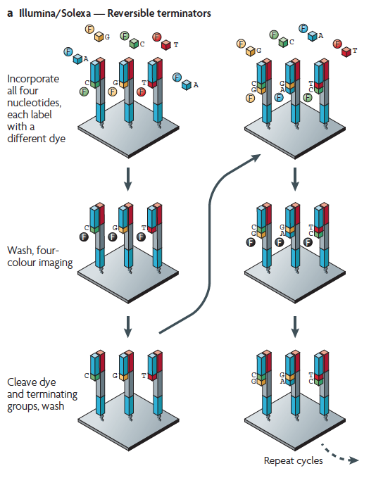
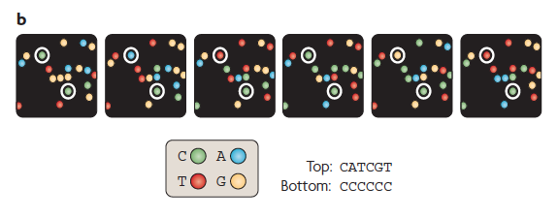
Illumina – Reversible terminators
https://www.youtube.com/watch?v=womKfikWlxM
Metzker, ML (2010), Nat. Rev. Genet, 11, pp. 31-46

Slide 10
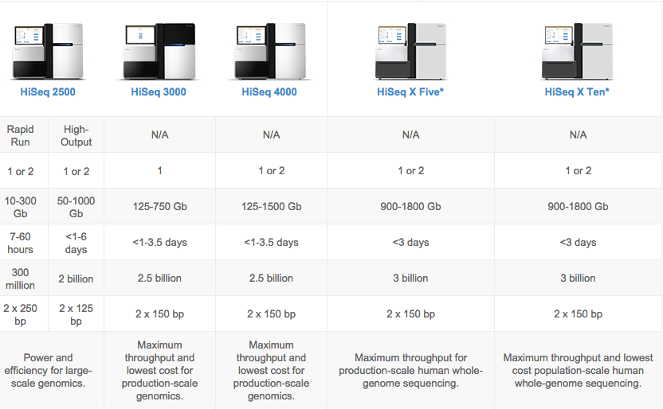
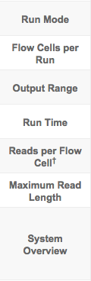
Illumina Platforms
https://www.illumina.com/systems/sequencing-platforms.html

Slide 11
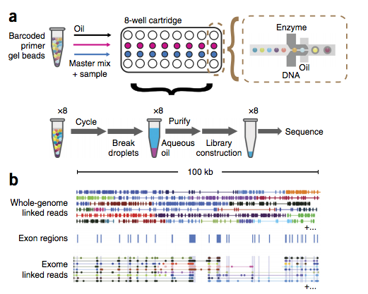
Applications of Illumina – Linked Read Sequencing
10X Genomics
Synthetic “long-read” technology through “linked read” resequencing
Captures a barcode-oligo coated gel-bead at 0.3X genome coverage, sequences and then assembles
Enables phased analysis for megabase-scale haplotyping
Zheng, GX et al (2016), Nat. Biotechnol, 34(3), pp. 303-11

Slide 12
Other Sequencing Strategies
Illumina’s “Sequencing by Synthesis” has the largest market share of short-read sequencing technologies
However, there are other sequencing platforms that have emerged and, in most cases, disappeared over time
These utilize alternative strategies, including “Sequencing by Ligation” and “Pyrosequencing”
The next few slides will briefly introduce these concepts, though most of the underlying technologies are considered legacy at this point.

Slide 13
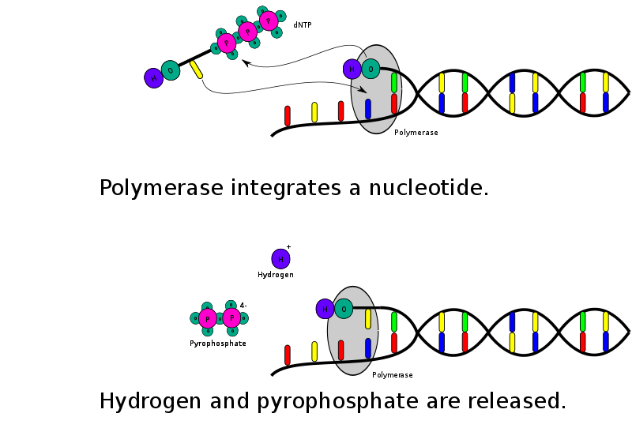
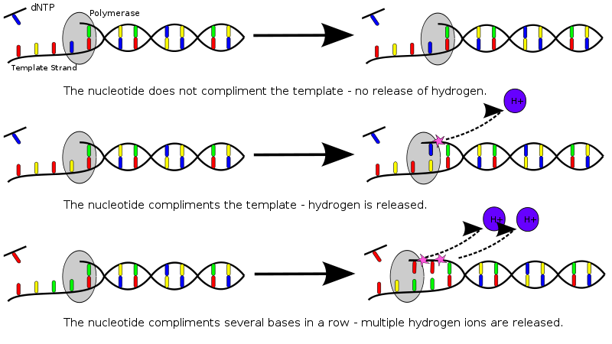
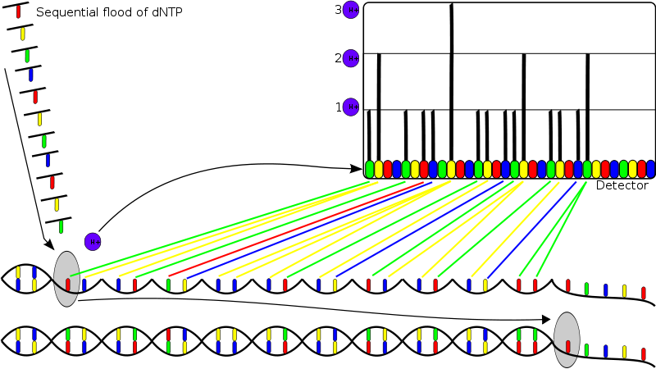
PGM - Ion Semiconductor Sequencing
Still in use!
Wikipedia, “Ion Semiconductor Sequencing”, September 26, 2012

Slide 14
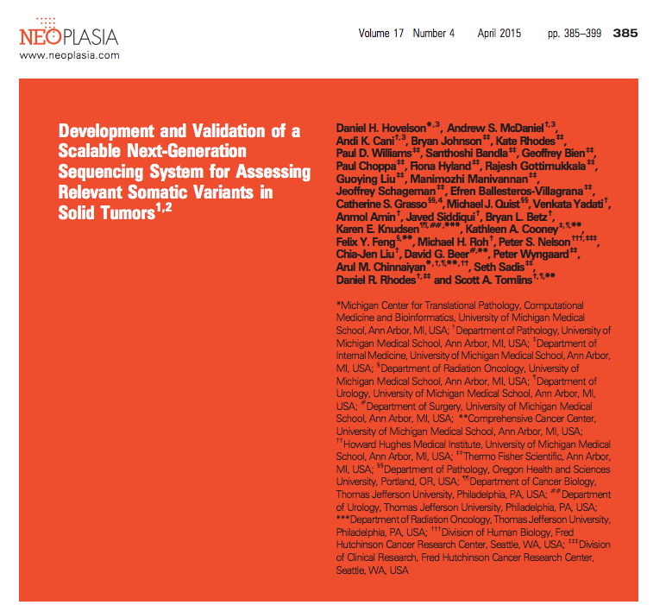
Ion Torrent – In Local Practice
AmpliSeq – Targets custom sets of genes
Ion Torrent 318 Chip
4 Hour sequencing run
<20 ng of DNA/RNA from FFPE tissue

Slide 15
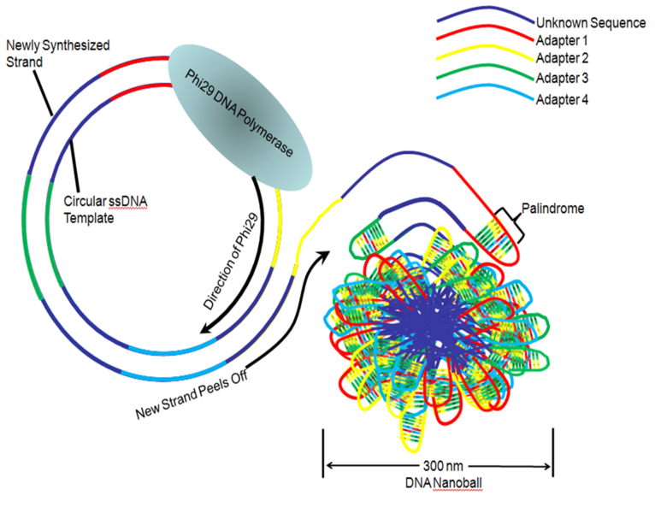
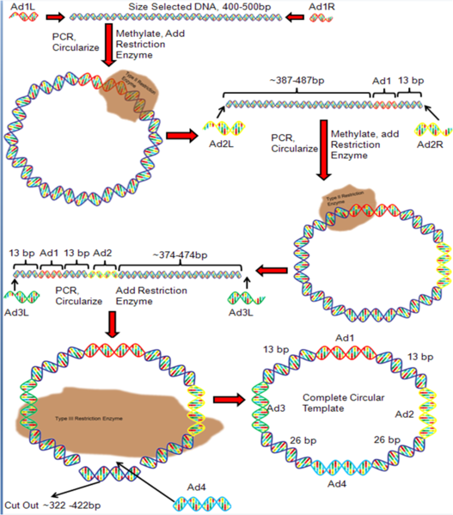
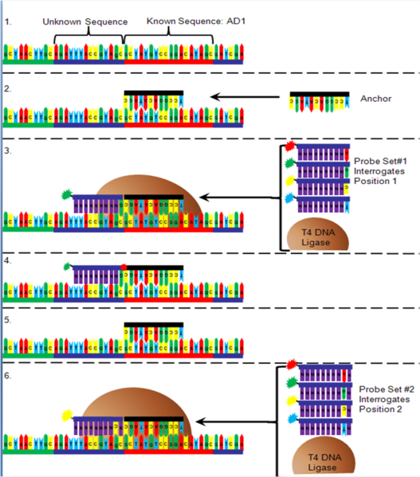
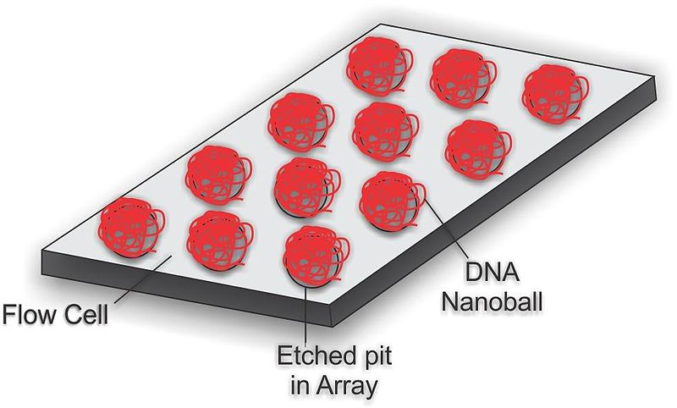
Complete Genomics – Nanoball Sequencing
Has proofreading ability!
Primary sequencing strategy employed by BGI-Seq!
Niedringhaus, TP et al (2011), Analytical Chem., 83, pp. 4327-4341
Wikipedia, “DNA Nanoball Sequencing”, September 26, 2012

Slide 16
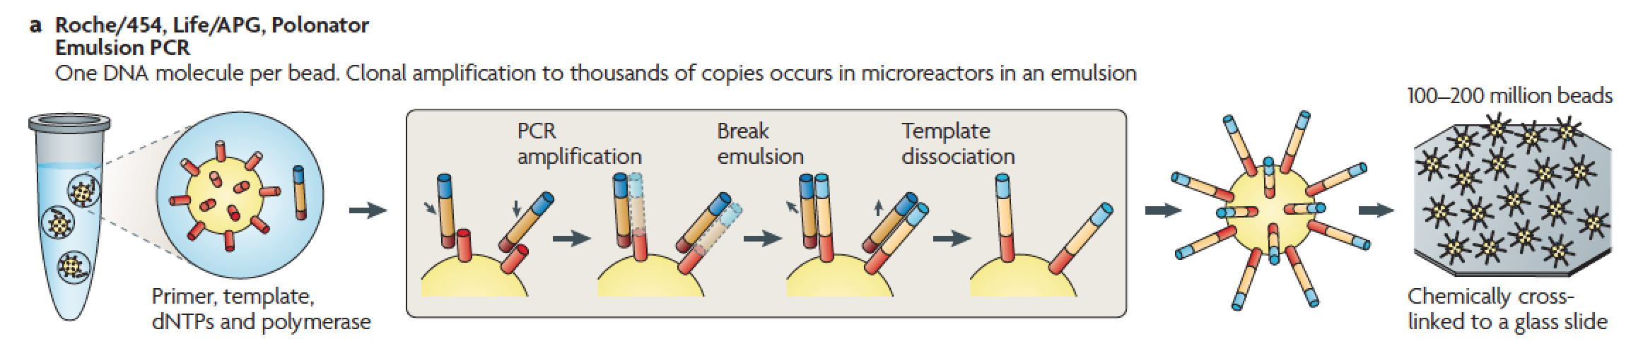
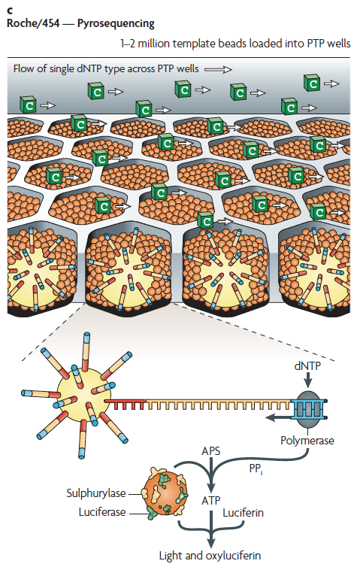
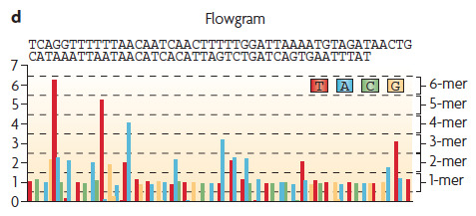
Roche 454 - Pyrosequencing
Legacy Technology – You won’t see in the wild!
Metzker, ML (2010), Nat. Rev. Genet, 11, pp. 31-46

Slide 17
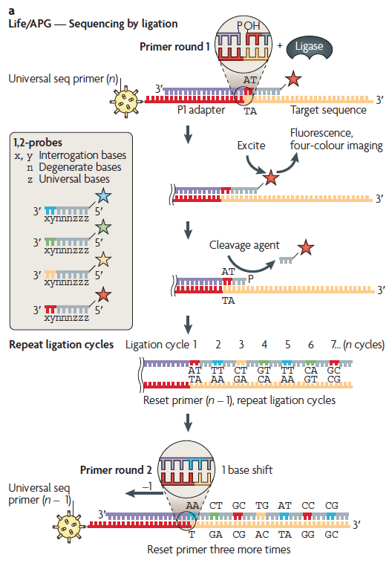
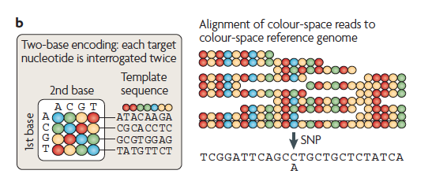
Thermo Fisher SOLiD – Sequence by Ligation
Legacy Technology – You won’t see in the wild!
Metzker, ML (2010), Nat. Rev. Genet, 11, pp. 31-46

